Slide 1
AS91896(2.7) & AS91887(2.8) Documentation
Elmé Pieterse

Slide 2
Burger Menu Combos
Link to your main (OneDrive) project folder:
https://middletonschoolnz-my.sharepoint.com/:f:/g/personal/pietersee_middleton_school_nz/Elb65JR21lFArNBtIwrVKLUBsEzDSffUPNHv9ZCL3_f43w?e=6iQdJ3
Link to GitHub Repository:
https://github.com/PIETERSEelmeEP/Assessment
Links to Trello board / project management tools: https://trello.com/invite/b/lFg3E4Jz/ATTIf6c5f1641a0254c466f73d1e70d0c1f6F44F18B1/burger-menu-combos
Link to final version of your program:
https://middletonschoolnz-my.sharepoint.com/:u:/g/personal/pietersee_middleton_school_nz/ETROMZBMt15DjMihnlZqbt8BxAf7TI5O2e5U1T0ubNoHDA?email=P.Baker%40middleton.school.nz&e=IRsDb3

Slide 3
Explain relevant Implications:
Relevant implication | Explain the implication and say how it is relevant to this project
Functionality | Functionality is making sure that the project works/does its purpose. It should work for expected, boundary, and unexpected cases. For example, if my program asks what meal combo the user is searching for, it should work for expected input like ‘Cheezy’.
Usability | Usability is the program doing what you want in the simplest method. It makes the messages/errors and instructions easy to read and understand for the user. Minimizing any frustration.
Aesthetics | Aesthetics is the overall appearance of the program. The program must look good with well spaced instructions, prompts, and ‘decoration’ around the major messages , resulting in a more pleasing(aesthetic) one composed of unspaced plain text.
Social | The social implications is about the computer program affects the users, the larger community, and the whole of society. For example, this program organises and edits the menu of a burger place, which could have a negative impact on society due to societies obesity rates. It is important to use inoffensive and culturally neutral, feedback, instructions that are clear and unambiguous.
Future Proofing | Making a program that is flexible, adaptable, and easy to edit later if necessary. It should be set so that another programmer can edit your work. Whoever wants to edit the code should be able to understand the purpose and reasoning for each part of the code. It's important to use constants than literals, to lessen the number of changes made.
Notes:
Additional rows can be added by clicking in the last cell and then using the Tab key

Slide 4
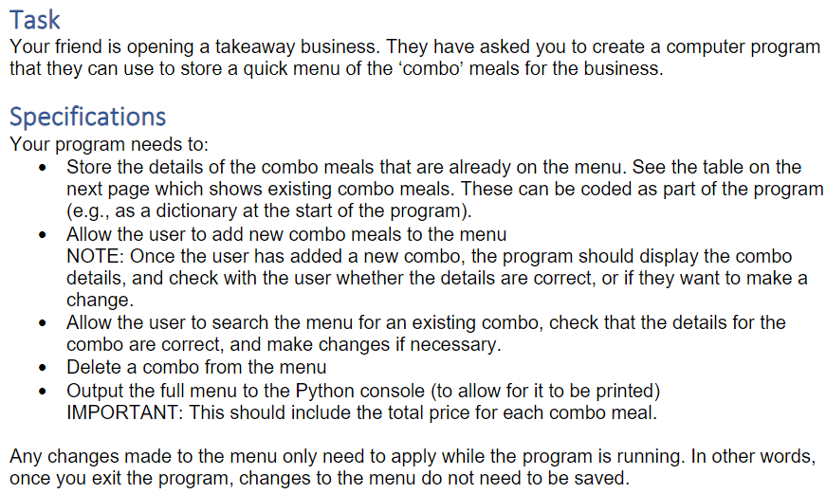
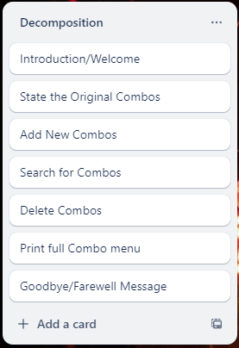
Decomposition:
Notes:
Paste screenshots of your initial Trello board / task decomposition on this slide. If you have a long list, you might need to break it up into several slides.

Slide 5
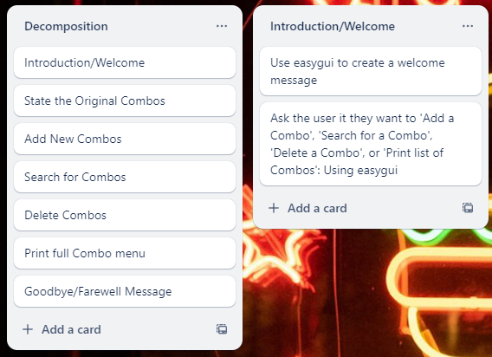
Component One (Introduction/Welcome)

Slide 6
Instruction/Welcome - Test Plan
Test Cases - input | Expected output
Ok | Program Continues
Add Combo | Program Continues
Search for Combo | Program Continues
Delete Combo | Program Continues
Print Full Combo Menu | Program Continues
Notes:
Additional rows can be added by clicking in the last cell and then using the Tab key

Slide 7
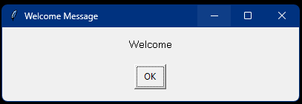
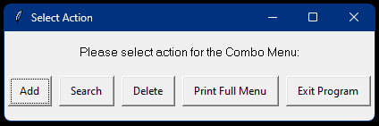
Introduction/Welcome: Testing
Test Cases - input | Expected output
Ok | Program Continues
Add Combo | Program Continues
Search for Combo | Program Continues
Delete Combo | Program Continues
Print Full Combo Menu | Program Continues
Exit Program | Program Finishes
Notes:
You must show the results of testing. For each component, include a screenshot proving it works. You can also include notes about each test.

Slide 8
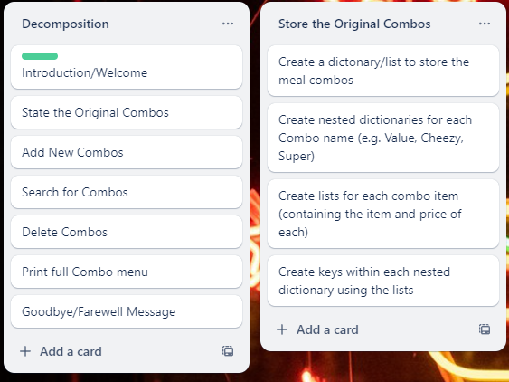
Component Two (Store/State the Original Combo Meals)

Slide 9
Store/State the Original Combo Meals - Test Plan
Test Cases - input | Expected output
print_combo_menu() | Combo Name: Value Items & Price: Beef Burger: 5.69 Fries: 1.00 Fizzy Drink: 1.00 Combo Name: Cheezy Items & Price: Cheeseburger: 6.69 Fries: 1.00 Fizzy Drink: 1.00 Combo Name: Super Items & Price: Cheeseburger: 6.69 Large Fries: 2.00 Smoothie: 2.00
Notes:
Additional rows can be added by clicking in the last cell and then using the Tab key

Slide 10
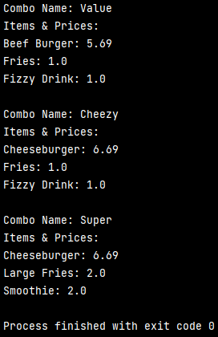
Store/State the Original Combo Meals: Testing
Test Cases - input | Expected output
print_combo_menu() | Combo Name: Value Items & Price: Beef Burger: 5.69 Fries: 1.00 Fizzy Drink: 1.00 Combo Name: Cheezy Items & Price: Cheeseburger: 6.69 Fries: 1.00 Fizzy Drink: 1.00 Combo Name: Super Items & Price: Cheeseburger: 6.69 Large Fries: 2.00 Smoothie: 2.00
Notes:
You must show the results of testing. For each component, include a screenshot proving it works. You can also include notes about each test.

Slide 11
Store/State the Original Combo Meals: Trialing
Trial 1 02_Store_Original_Combo_Meals_v1 | Program works but uses list. Preferably the program must use dictionaries instead of lists for most efficiency within this program.
Trial 2 02_Store_Original_Combo_Meals_v2 | Program works. It consists of dictionaries; however, it still uses a list. Making it efficient, but it's not the most efficient method to use for the program.
Trial 3 02_Store_Original_Combo_Meals_v3 | Program works and the nested dictionary is more efficient than using lists. The nested dictionary is the most efficient and preferred method to use for the program and its purpose.
Trial 4 02_Store_Original_Combo_Meals_v4 | I made the print code, from Trial 3, into a function which makes it easy to recycle for other print functions I might incorporate into my program. I will therefore use this function in my final program.
Notes:
NOTE: Trialling needs to happen for at least 2 of your components but is not necessary for ALL components.
Trialling is not the same as testing. Trialling is about finding different ways of building the same component. Show evidence of your trialling here. Select one of your trials for further development and give reasons for your choice.

Slide 12
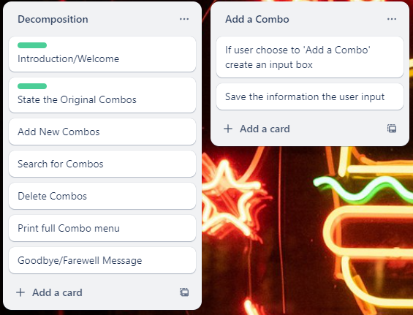
Component Three (Add New Combo Meals)

Slide 13
Add New Combo Meals - Test Plan
Test Cases – input (Combo Name) | Expected output
‘Supreme’ in Combo Name | Program Continues
‘123’ in Combo Name | Program Continues
Test Cases – input (For any 3 items price) | Expected output
‘2.45’ in price 1 | Program Continues
‘1’ in price 1 | Program Continues
‘five’ | It must be an integer Please enter a price
Test Cases – input (For any 3 Items) | Expected output
‘Pork Burger’ | Program Continues
‘123’ | Program Continues
Notes:
Additional rows can be added by clicking in the last cell and then using the Tab key

Slide 14
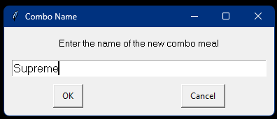
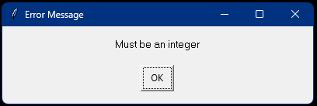
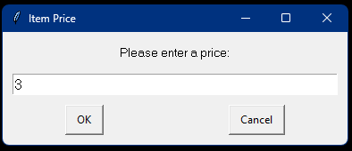
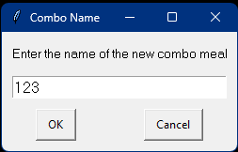
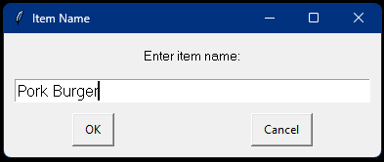
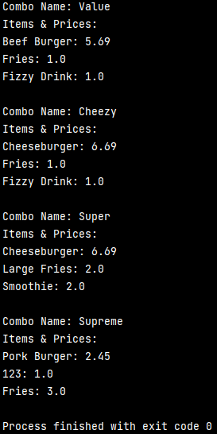
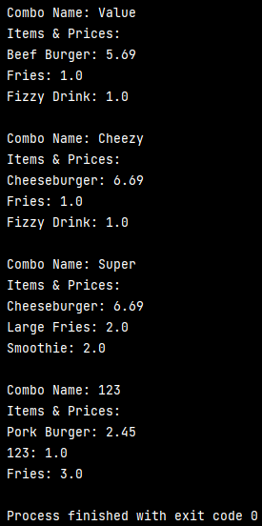
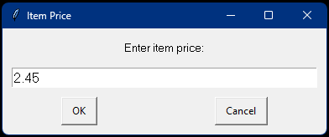
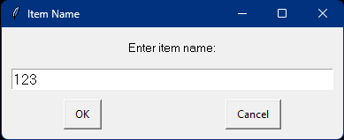
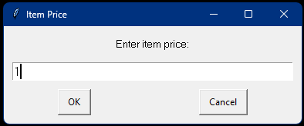
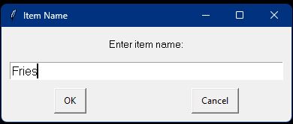
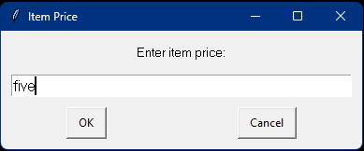
Add New Combo Meals: Testing
The code below is almost a replica of the previous code, except the combo's name is entered as 123 instead of Supreme for testing purposes
Test Cases – input (Combo Name) | Expected output
‘Supreme’ in Combo Name | Program Continues
‘123’ in Combo Name | Program Continues
Test Cases – input (For any 3 Items) | Expected output
‘Pork Burger’ | Program Continues
‘123’ | Program Continues
Test Cases – input (For any 3 items price) | Expected output
‘2.45’ in price 1 | Program Continues
‘1’ in price 1 | Program Continues
‘five’ | It must be an integer. Please enter a price
Notes:
You must show the results of testing. For each component, include a screenshot proving it works. You can also include notes about each test.

Slide 15
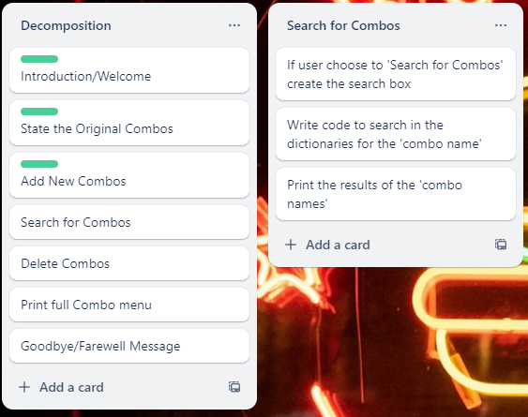
Component Four (Search for Combo Meal or Items)

Slide 16
Search for Combo Meal or Items - Test Plan
Test Cases – input | Expected output
Value | Results: Combo Name: Value Items & Price: Beef Burger: 5.69 Fries: 1.00 Fizzy Drink: 1.00
Cheezy | Results: Combo Name: Cheezy Items & Price: Cheeseburger: 6.69 Fries: 1.00 Fizzy Drink: 1.00
Super | Results: Combo Name: Super Items & Price: Cheeseburger: 6.69 Large Fries: 2.00 Smoothie: 2.00
Supreme | There are no Combos named Supreme Nor are there any items within Combos named Supreme
Cheeseburger | Results: Combo Name: Cheezy Items & Price: Cheeseburger: 6.69 Fries: 1.00 Fizzy Drink: 1.00 Combo Name: Super Items & Price: Cheeseburger: 6.69 Large Fries: 2.00 Smoothie: 2.00
Notes:
Additional rows can be added by clicking in the last cell and then using the Tab key

Slide 17
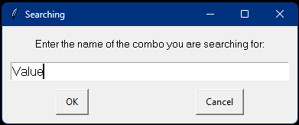
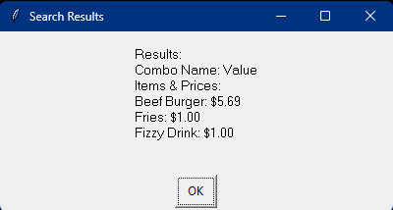
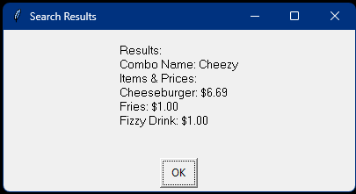
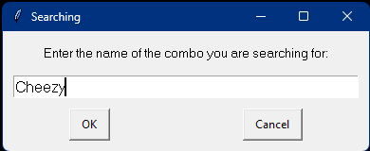
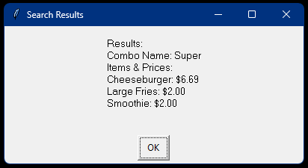
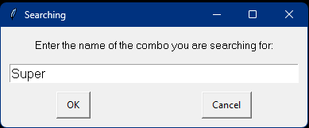
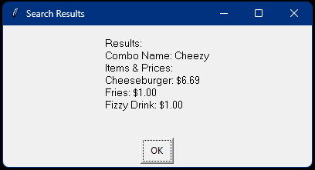
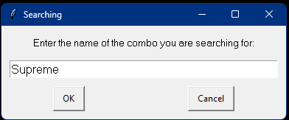
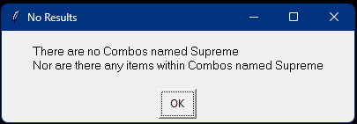
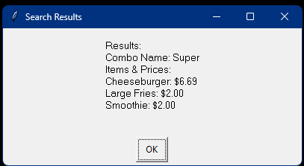
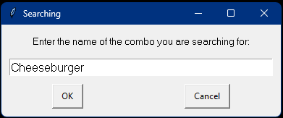
Search for Combo Meals Or Items: Testing
Test Cases – input | Expected output
Value | Results: Combo Name: Value Items & Price: Beef Burger: 5.69 Fries: 1.00 Fizzy Drink: 1.00
Cheezy | Results: Combo Name: Cheezy Items & Price: Cheeseburger: 6.69 Fries: 1.00 Fizzy Drink: 1.00
Super | Results: Combo Name: Super Items & Price: Cheeseburger: 6.69 Large Fries: 2.00 Smoothie: 2.00
Supreme | There are no Combos named Supreme Nor are there any items within Combos named Supreme
Cheeseburger | Results: Combo Name: Cheezy Items & Price: Cheeseburger: 6.69 Fries: 1.00 Fizzy Drink: 1.00 Combo Name: Super Items & Price: Cheeseburger: 6.69 Large Fries: 2.00 Smoothie: 2.00
Notes:
You must show the results of testing. For each component, include a screenshot proving it works. You can also include notes about each test.

Slide 18
Search for Combo Meal or Item: Trialing
Trial 1 04_Search_Combo_Items_v1 | Program works; however, the user is limited to only searching for a combo name/meal. It prints all the results. Resulting in it not being very efficient.
Trial 2 04_Search_Combo_Items_v2 | Program works. This version allows the user more leverage in what they can search for. It isn’t limited to only searching for a combo name/meal, it allows the user to search for a specific item within all the combos and prints all the combos that contains the item.
Trial 3 04_Search_Combo_Items_v3 | Program works and allows the user to search for both combo names/meals and items within the combos. This version is more efficient and reusable than 04_Search_Combo_Items_v2 do to having been placed in functions.
Trial 4 04_Search_Combo_Items_v4 | Program works and allows the user to search for both combo names/meals and items within the combos. However, it uses easygui instead of the python console.
Notes:
NOTE: Trialling needs to happen for at least 2 of your components but is not necessary for ALL components.
Trialling is not the same as testing. Trialling is about finding different ways of building the same component. Show evidence of your trialling here. Select one of your trials for further development and give reasons for your choice.

Slide 19
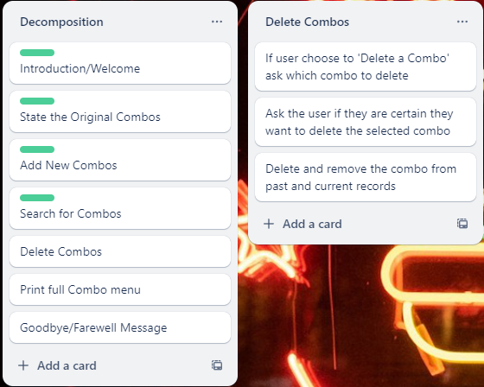
Component Five (Delete Combo Meal)

Slide 20
Delete Combo Meal - Test Plan
Test Cases – input (Enter combo you want to delete) | Expected output
Value | Do you want to delete: Combo Name: Value Items & Price: Beef Burger: 5.69 Fries: 1.00 Fizzy Drink: 1.00
Cheezy | Do you want to delete: Combo Name: Cheezy Items & Price: Cheeseburger: 6.69 Fries: 1.00 Fizzy Drink: 1.00
Super | Do you want to delete: Combo Name: Super Items & Price: Cheeseburger: 6.69 Large Fries: 2.00 Smoothie: 2.00
Supreme | There are no Combos named Supreme
Test Cases – input (Are you sure you want to delete this combo? (yes/no)) | Expected output
Yes | Combo 'Cheezy' deleted successfully!
no | Deletion cancelled
Notes:
Additional rows can be added by clicking in the last cell and then using the Tab key

Slide 21
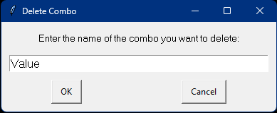
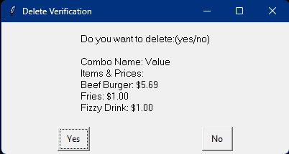
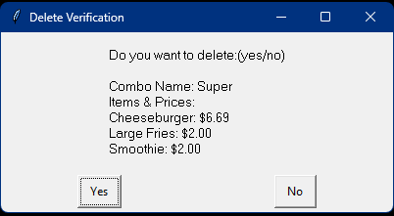
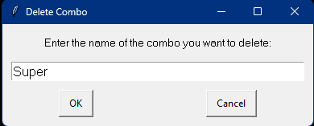
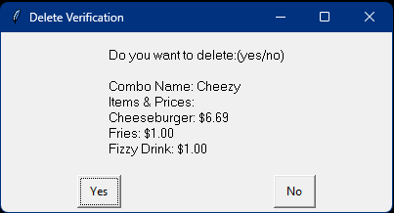
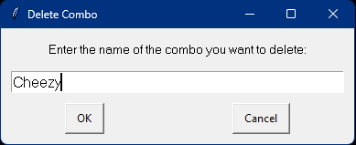
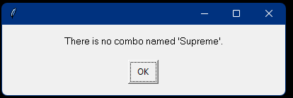
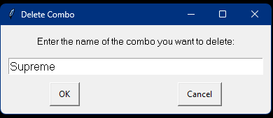
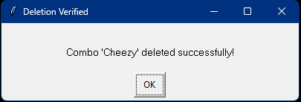
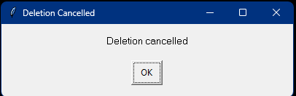
Delete Combo Meal: Testing
Test Cases – input (Enter combo you want to delete) | Expected output
Value | Do you want to delete: Combo Name: Value Items & Price: Beef Burger: 5.69 Fries: 1.00 Fizzy Drink: 1.00
Super | Do you want to delete: Combo Name: Super Items & Price: Cheeseburger: 6.69 Large Fries: 2.00 Smoothie: 2.00
Cheezy | Do you want to delete: Combo Name: Cheezy Items & Price: Cheeseburger: 6.69 Fries: 1.00 Fizzy Drink: 1.00
Supreme | There are no Combos named Supreme
Test Cases – input (Are you sure you want to delete this combo? (yes/no)) | Expected output
Yes | Combo 'Cheezy' deleted successfully!
no | Deletion cancelled
Notes:
You must show the results of testing. For each component, include a screenshot proving it works. You can also include notes about each test.

Slide 22
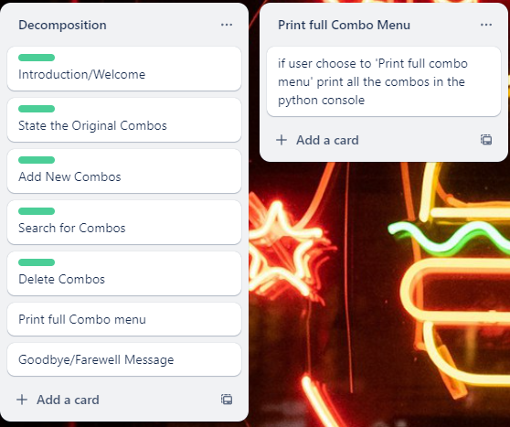
Component Six (Print Full Combo Menu)

Slide 23
Print Full Combo Menu - Test Plan
Test Cases - input | Expected output
Print Full Menu | Combo Name: Value Items & Price: Beef Burger: 5.69 Fries: 1.00 Fizzy Drink: 1.00 Combo Name: Cheezy Items & Price: Cheeseburger: 6.69 Fries: 1.00 Fizzy Drink: 1.00 Combo Name: Super Items & Price: Cheeseburger: 6.69 Large Fries: 2.00 Smoothie: 2.00
Notes:
Additional rows can be added by clicking in the last cell and then using the Tab key

Slide 24
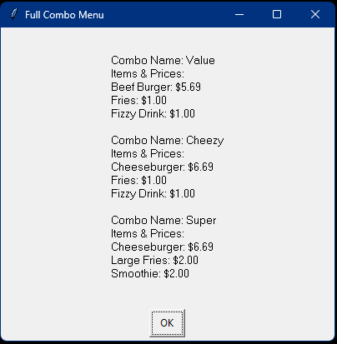
Print Full Combo Menu: Testing
Test Cases - input | Expected output
Print Full Menu | Combo Name: Value Items & Price: Beef Burger: 5.69 Fries: 1.00 Fizzy Drink: 1.00 Combo Name: Cheezy Items & Price: Cheeseburger: 6.69 Fries: 1.00 Fizzy Drink: 1.00 Combo Name: Super Items & Price: Cheeseburger: 6.69 Large Fries: 2.00 Smoothie: 2.00
Notes:
You must show the results of testing. For each component, include a screenshot proving it works. You can also include notes about each test.

Slide 25
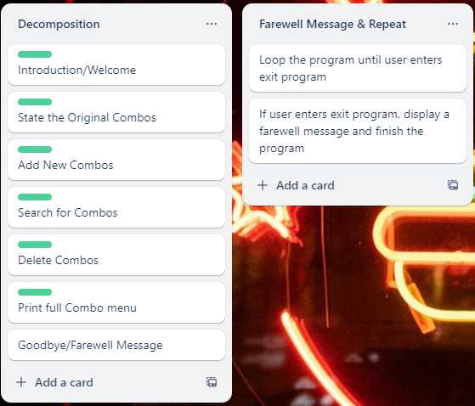
Component Seven (Goodbye/Farewell Message & Repeat)

Slide 26
Instruction/Welcome - Test Plan
Test Cases - input | Expected output
Exit Program | Farewell Program Finishes
Notes:
Additional rows can be added by clicking in the last cell and then using the Tab key

Slide 27
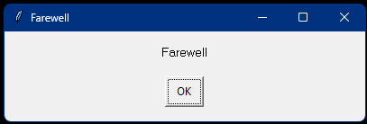
Store/State the Original Combo Meals: Testing
Test Cases - input | Expected output
Exit Program | Farewell Program Finishes
Notes:
You must show the results of testing. For each component, include a screenshot proving it works. You can also include notes about each test.

